Slide 1
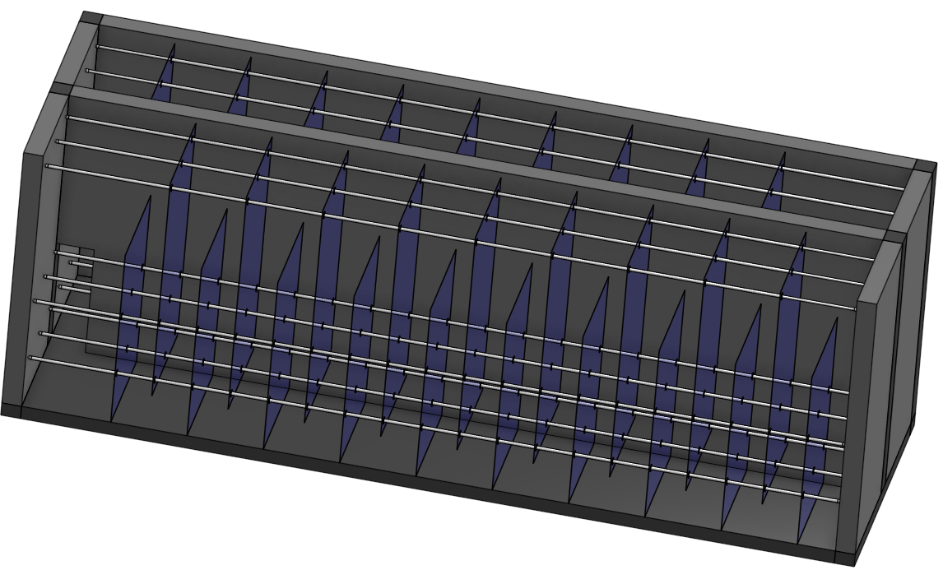
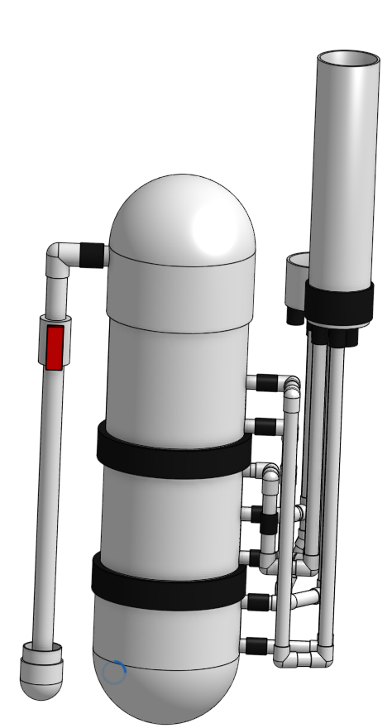

Fluids Review
Head loss, shear, vena contracta, and other concepts that enable a “smart fluids” design

Slide 2
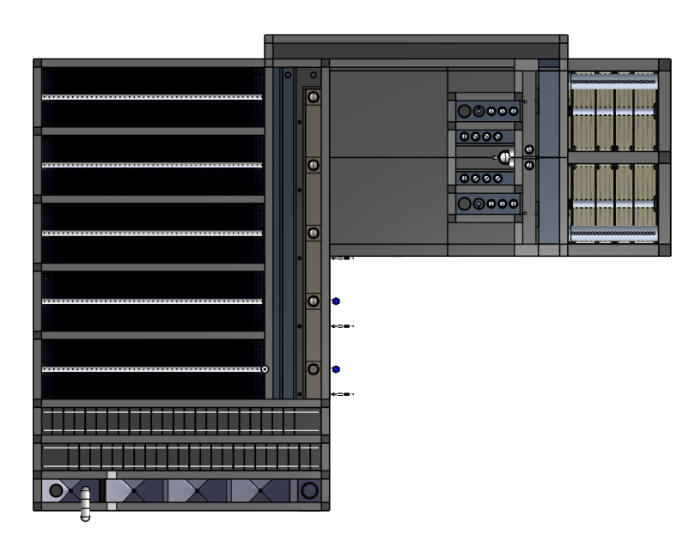
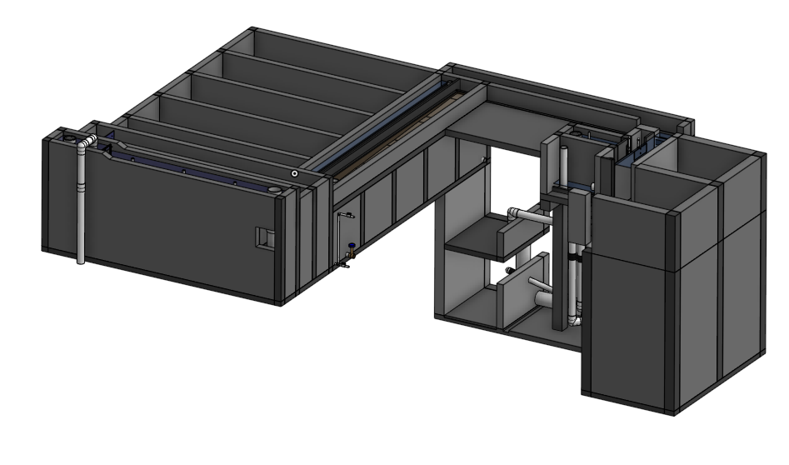
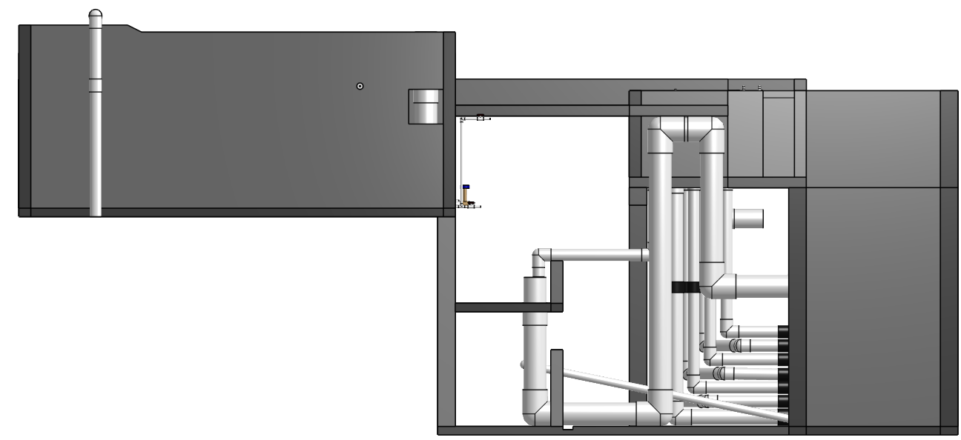
Preview of What Onshape Can Do Plant 10-80 L/s
Notes:
How does each unit know what flow rate to use in its design? (show FeatureStudio and how Qm_max is passed to children)
Look at how short the FeatureList is in the PS!
Show variables and explain that each child has its own map (or list) of variables
Show Bill of Materials, cost per L/s, every part has a price and cost per L/s
Show cut list and 755 plate settlers and upper and lower floc baffles.
Show
path of water through the plant
Side of et
end of a sed tank

Slide 3
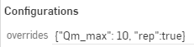
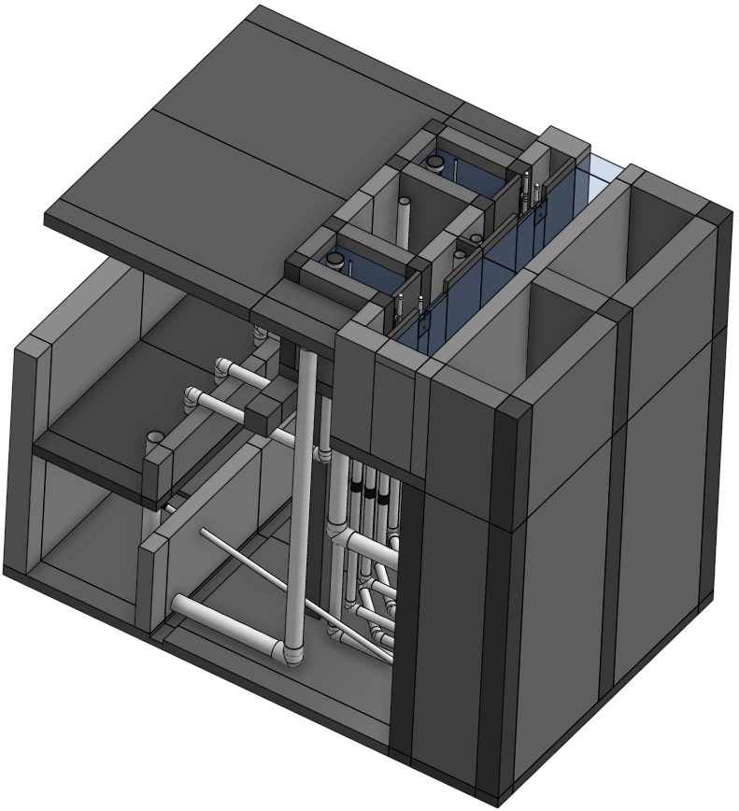
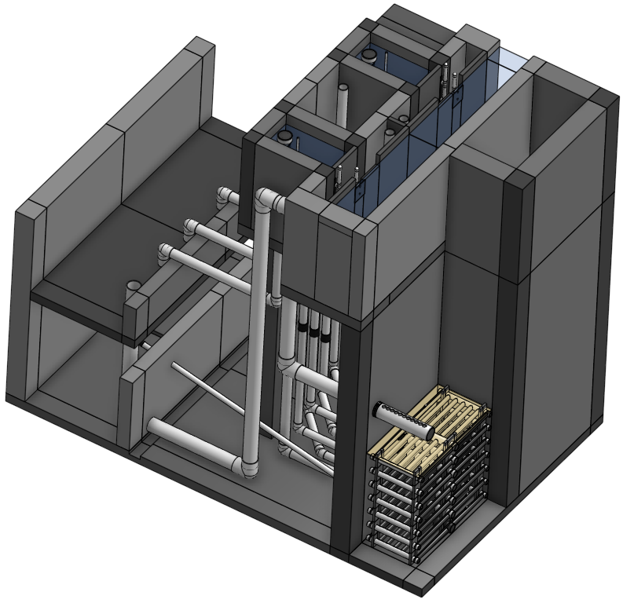
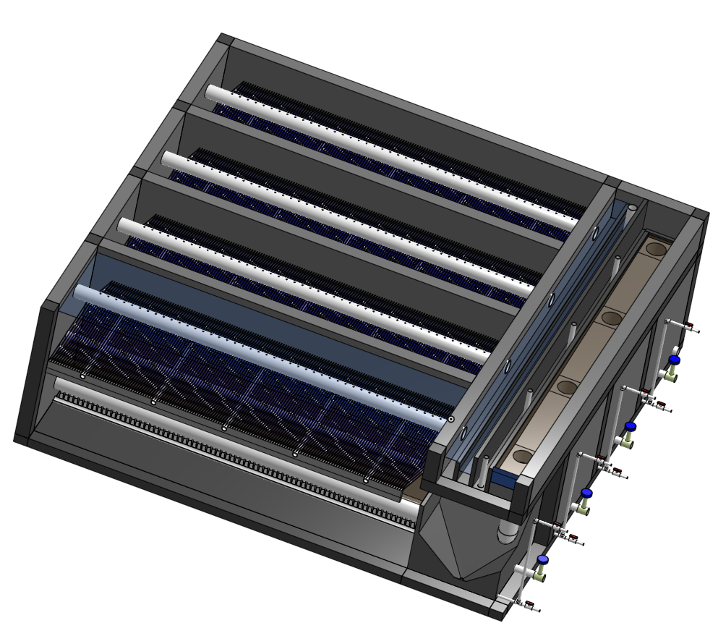
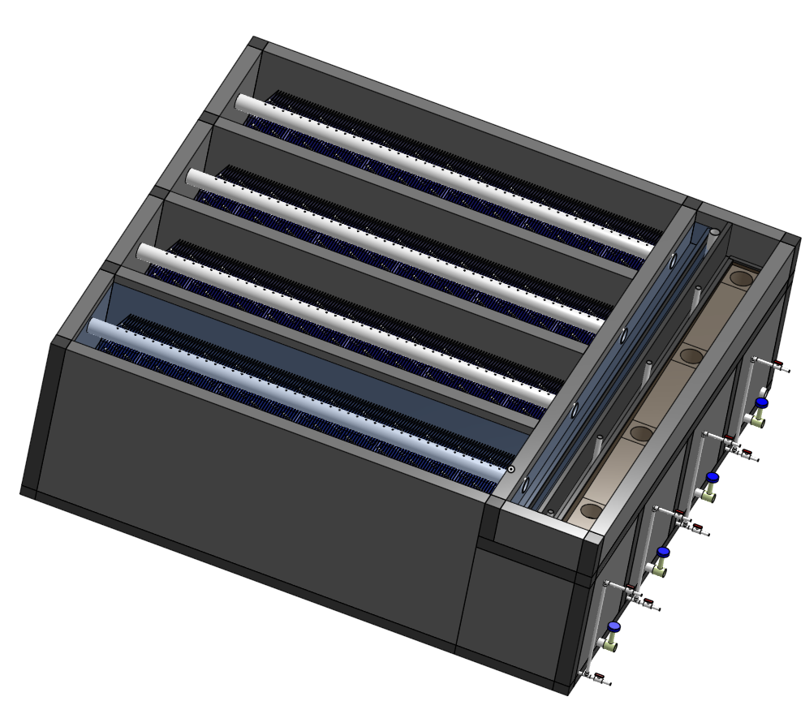
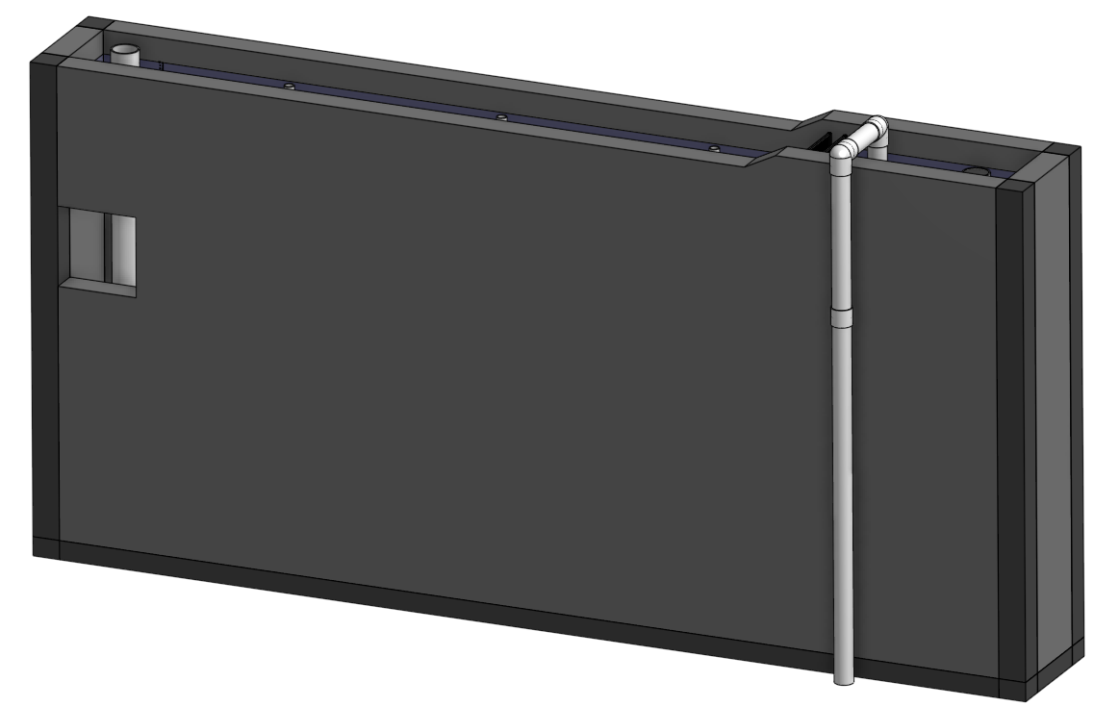
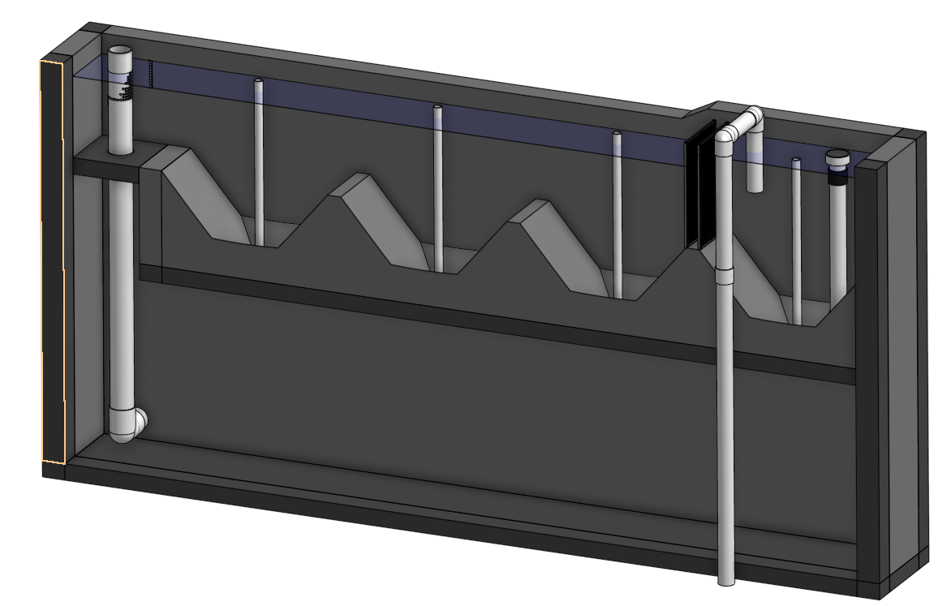
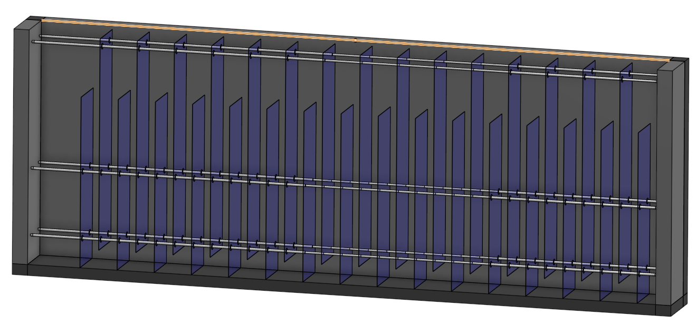
for parent
AguaClara water treatment plant
Parent can pass input parameters to children
Stacked Rapid Sand Filter
AguaClarifier
Sedimentation Tank
Entrance Tank
Flocculator

Slide 4
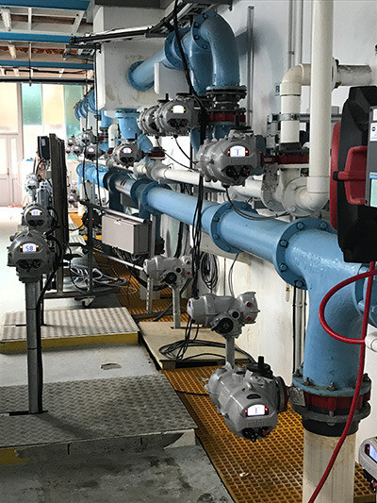
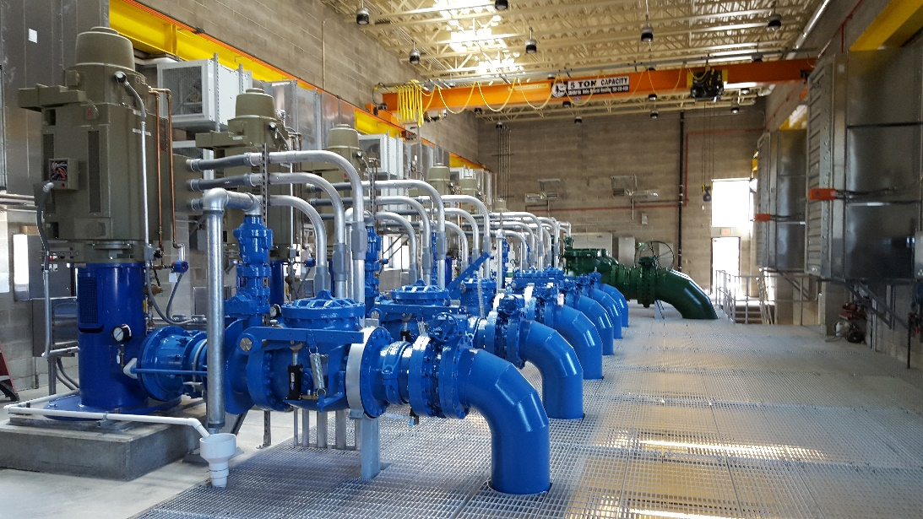
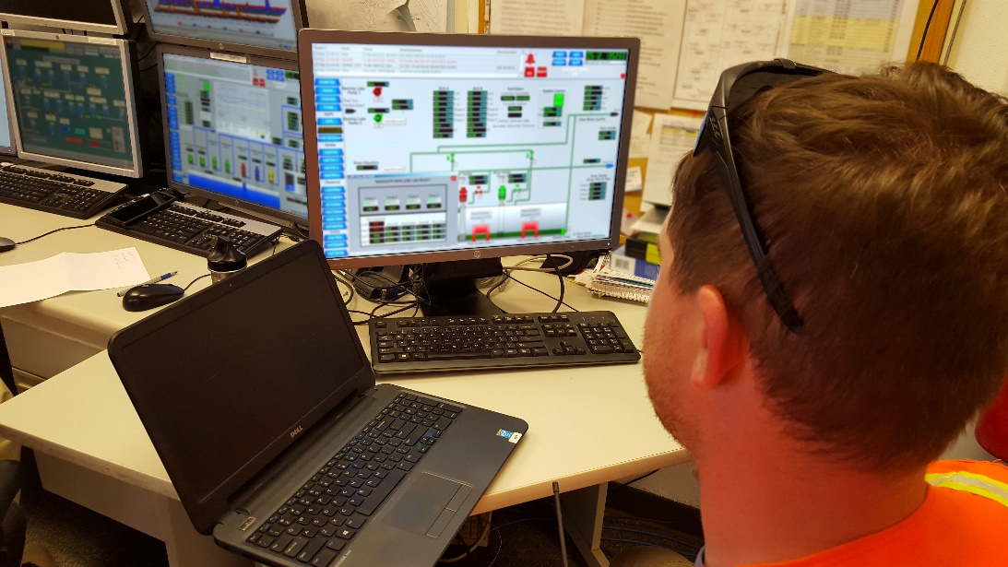
What didn’t you see?
Pumps
Conduits for electrical wires
Computers
Pneumatic control tubes

Slide 5
Computer controlled flows and water levels in water treatment plants
Are easier to design and MUCH harder to maintain
Enable consultants to pass design error risk off to the vendors
Introduce unnecessary complexity that gets in the way of successful plant operation because it is more difficult for the operators to diagnose problems
Have high part counts and layers of interdependent systems including water levels and flows, sensors, hardware to digitize signals, software, hardware to send control signals to valves, mechanized valves

Slide 6
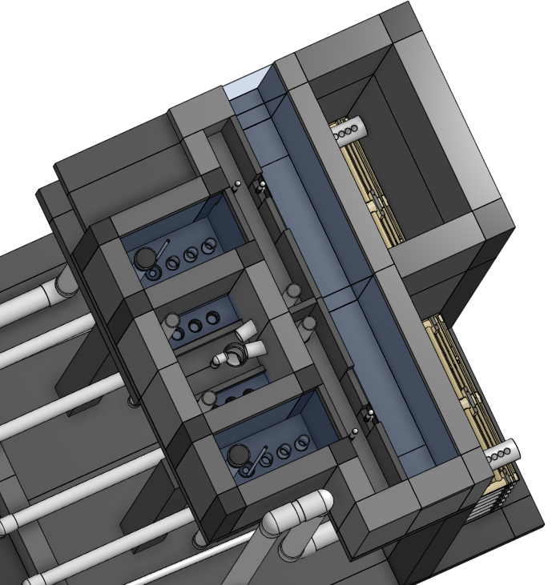
Motivation for Fluids
We use smart physics and fluids to create elegant designs
Create fail proof designs using smart hydraulic controls
Make it easy for operators to learn how their plant works
We eliminate all moving parts that aren’t needed
We design the geometry so the water makes all the right moves!
We write our plant operation code in concrete and PVC!
flow control including flow splitting between units in parallel
filter cycling between filtration and cleaning modes

Slide 7
Fluids Review
Drag (flow around objects)
Head loss (flow in pipes)
Bernoulli and Energy Equation

Slide 8

What causes the majority of air drag on a bicycle (including the rider)?
Pressure drag (normal force)
Shear drag (tangent force)
Lift drag

Slide 9
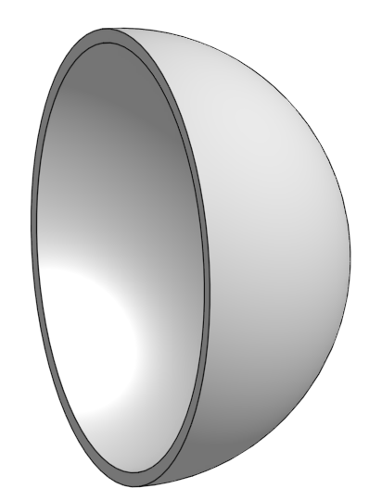
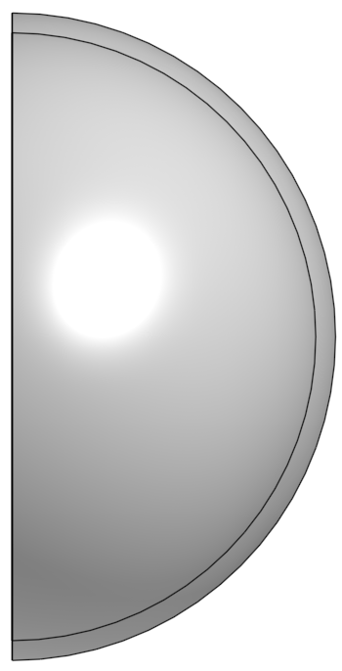
Which orientation causes more drag?
Round disk tangent to wind
Round disk perpendicular to wind
Hemisphere with convex side facing wind
Hemisphere with concave side facing wind

Slide 10
Streamlines
Draw the streamlines that begin on the upstream side of the object for these two cases
Which object has the larger wake?
Which object has the lower pressure in the wake? (if streamlines are bending hard at the point of separation, then the streamlines will be close together…)

Slide 11
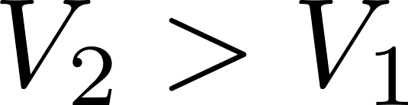
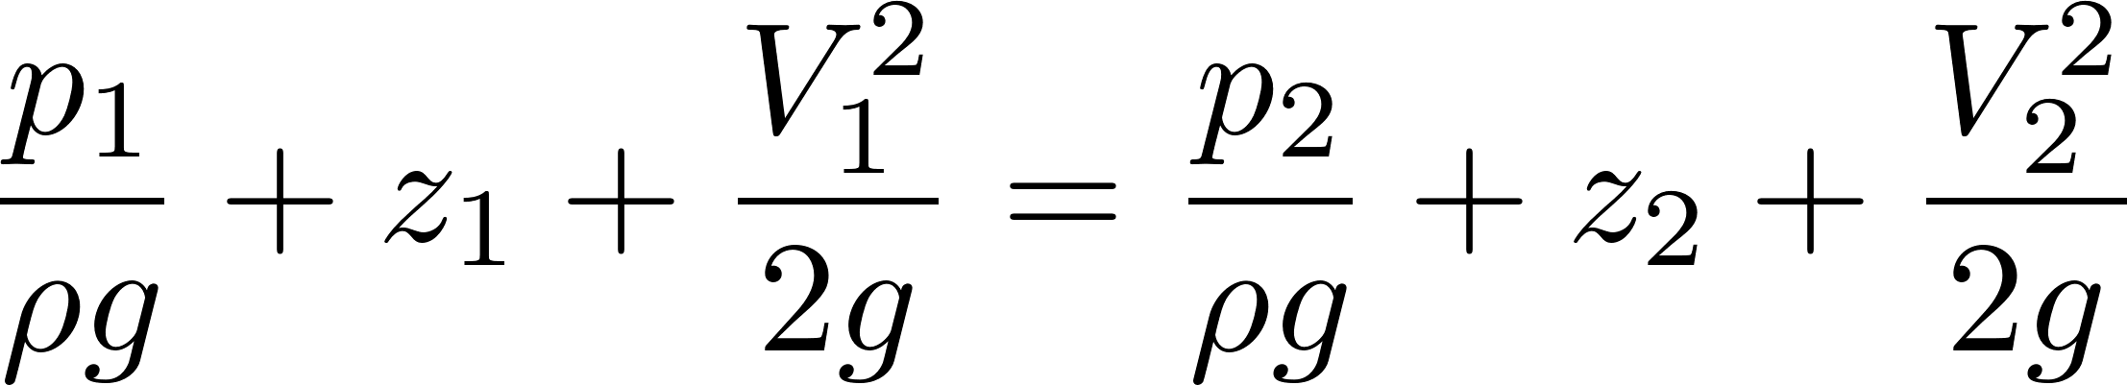
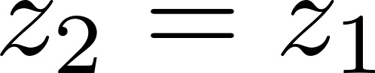
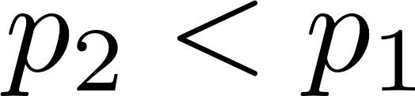
Why is there drag?
2
1
Fluid separates from solid body (can’t make the sharp turn!)
Apply Bernoulli equation
Pressure in the recirculation zone is low (drag) because velocity in the adjacent flowing fluid at the point of separation is high
Pressure in recirculation zone (the wake) is relatively uniform because velocities in recirculation zone are low
Streamlines closer (flow contraction at 2)
Flow curvature at point 2 makes pressure in wake even lower! (think hurricane)

Slide 12
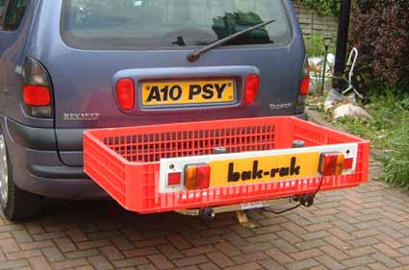
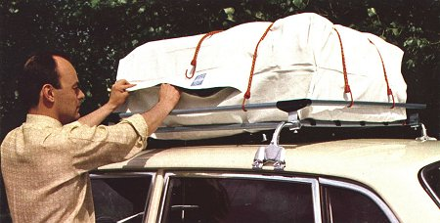
I’m going on vacation and I can’t pack all of our luggage in my car. Where should I put it for the lowest drag?
on the roof rack on top of the car.
on the hitch behind the car.

Slide 13
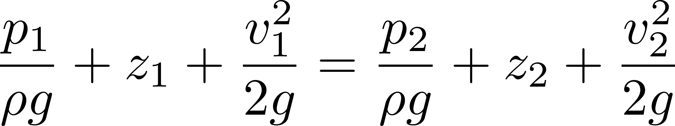
Which equation do you use to measure the head loss in a pipe system?
Control Volume Energy equation
Bernoulli equation
These are the same equations

Slide 14
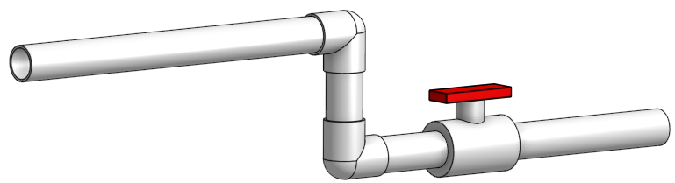
2
Control surface out
1
Control surface in
Bernoulli equation
Control Volume Energy equation
Along a streamline
Frictionless (no lost mechanical energy) – no flow expansions!
Constant density
Steady
Control volume is all of the fluid between the control surfaces
Tracks energy in and energy out
We can take measurements and use the control volume energy equation to calculate how much mechanical energy is being converted to heat
Average velocity through control surface
Velocity at a point
Pressure at centroid of control surface
Irreversible process! Can’t switch in and out!

Slide 15
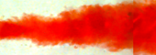
Where can you apply the Bernoulli equation?
Smooth flow contraction (acceleration: pressure converted to KE is efficient)
flow expansion (deceleration: KE to pressure is inefficient)
Mechanical energy conserved!
1
2
1
Some Mechanical energy converted to heat!
1
2
Notes:
How does the slow contraction vs. the quick contraction make a difference in how it transfers to heat?
Acceleration is efficient!!!!
Deceleration is inefficient!
Where can you apply Bernoulli?

Slide 16
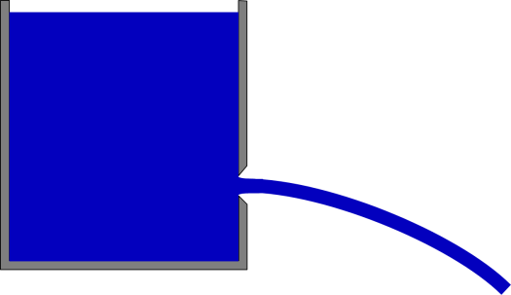
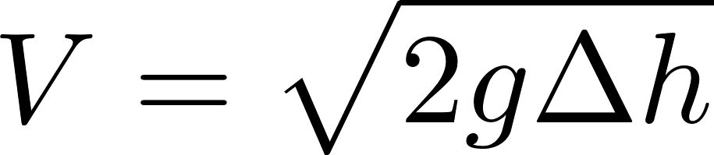
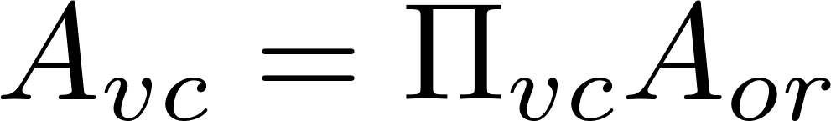

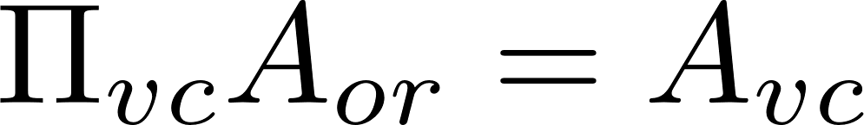

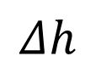
Orifice Equation: Flow Contraction – Use Bernoulli
z₁
$$Δh$$
z₂ = 0
Bernoulli equation (no energy loss)
mechanical
^
Area of the constricted flow
Vena contracta
Continuity equation
Orifice Equation (memorize this or, even better, remember how to derive it!)

Slide 17
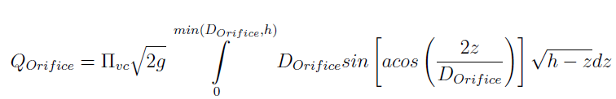
Orifice Equation
z₁
$$Δh$$
z₂ = 0
Flow contraction!
This equation applies to a horizontal orifice (so that the depth of submergence is constant throughout the entire orifice area). For depth of submergence larger than the diameter of the orifice this equation can be applied to vertical orifices. The USGS published a great solution for flow through partially submerged vertically oriented orifices

Slide 18
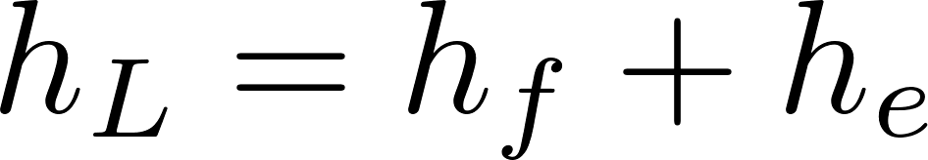
Two kinds of drag Two kinds of head loss
Lost mechanical energy represented as lost elevation
Drag (external flows)
Head loss (internal flows)
Skin (or shear) friction
Shear on solid surface
Classic example is flat plate
Form (or pressure) drag
Separation of streamlines from solid surface and wake results in a…
Flow expansion (behind object)
Major losses (h_{f} – friction)
Shear on solid surface
Shear on pipe walls
Minor losses (h_{e} – expansion)
Separation of streamlines from solid surface results in a…
Flow expansion (inside the pipe)
Energy equation (NOT THE BERNOULLI EQUATION)

Slide 19
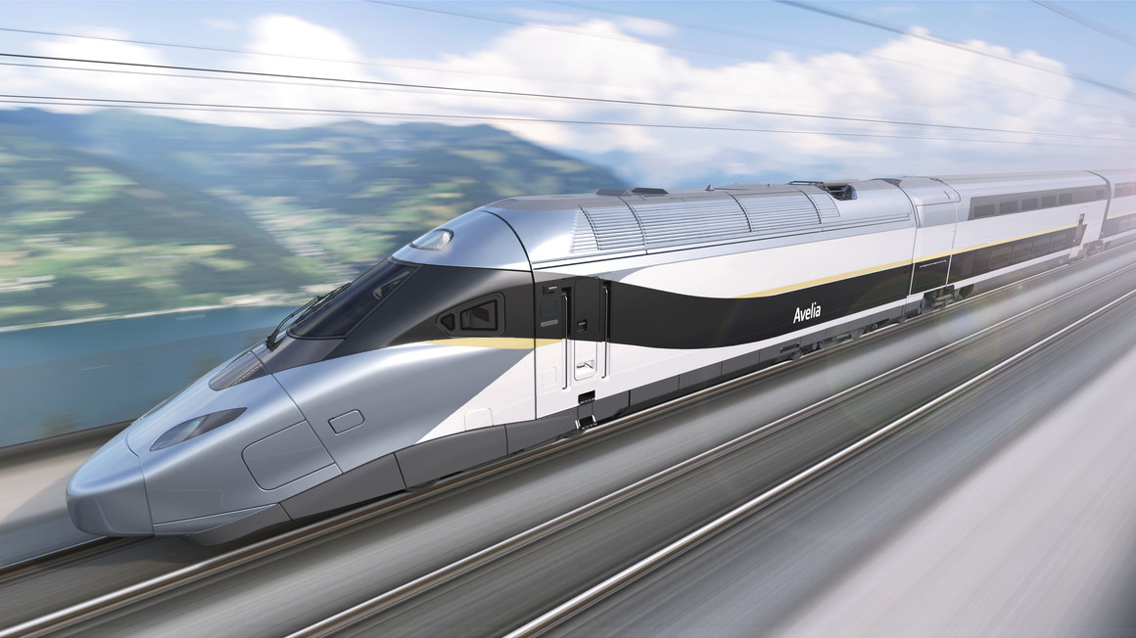
A long streamlined train and a long straight pipeline are similar in that
They both have significant energy losses due to shear between the fluid and the solid surface
They both have significant energy losses due to flow expansions

Slide 20
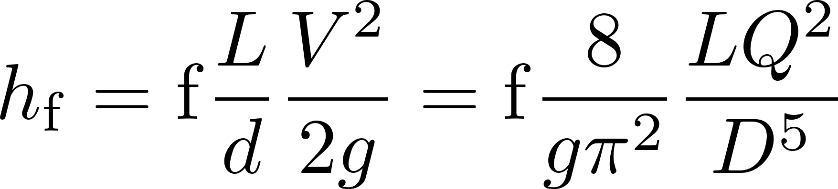
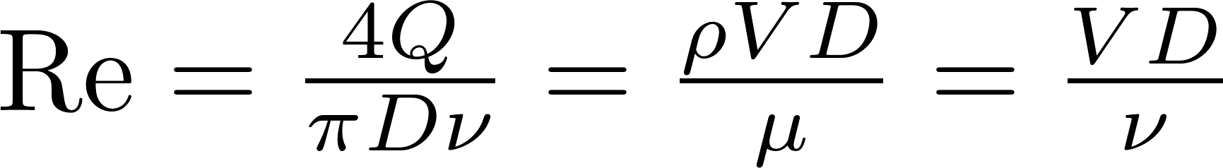
Head Loss in a Long STRAIGHT Tube (due to wall shear): Major Losses
Darcy Weisbach:
This equation gives the major losses for BOTH laminar and turbulent flow.
How can we find the friction factor for wall shear, f?
First, find Reynold’s number
Transition from turbulent to laminar occurs at Re~2100

Slide 21
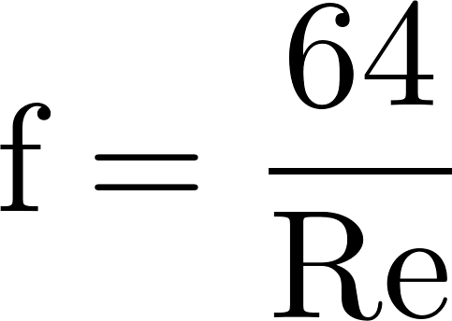
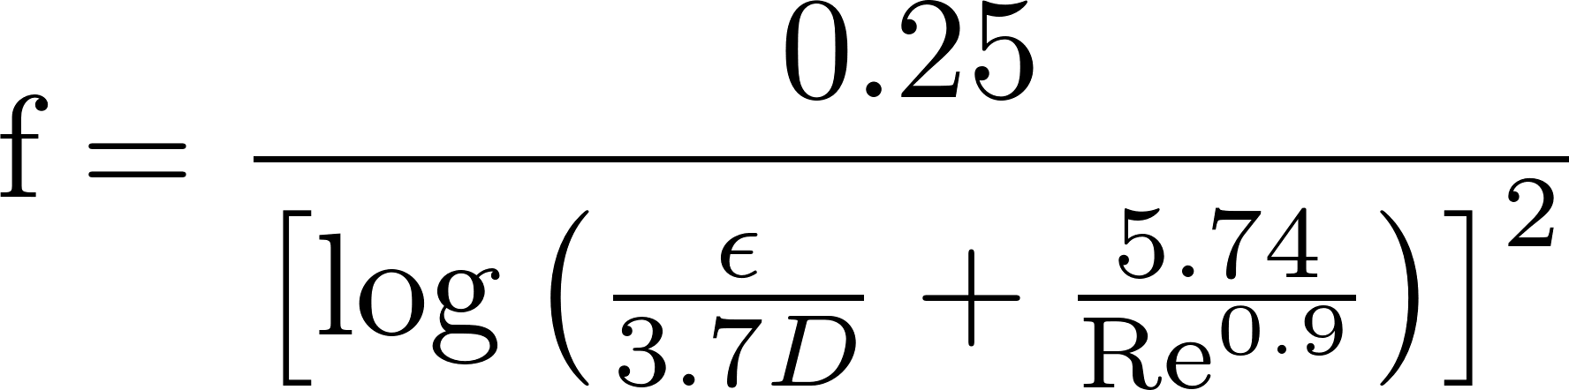

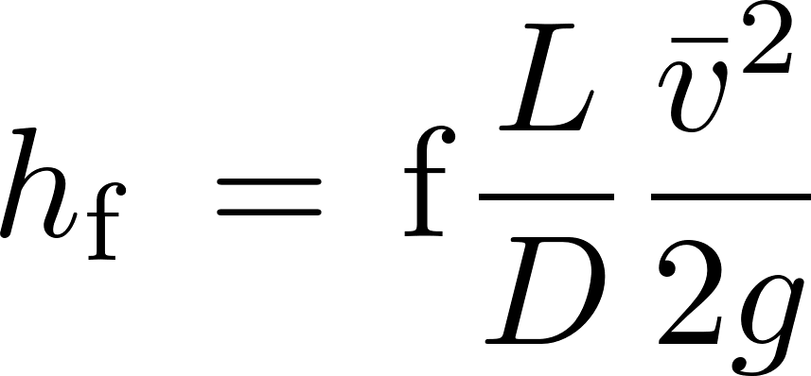
Head Loss in a Long STRAIGHT Tube (due to wall shear): Major Losses
Laminar
if Re < 2100,
Turbulent
if Re > 2100,
Swamee-Jain:
Major loss equation simplification
(for laminar flow only!):
Where Ɛ is the wall roughness
Hagen-Poiseuille:
(no h_{f} equation simplification😢)
h_{f} proportional flow

Slide 22
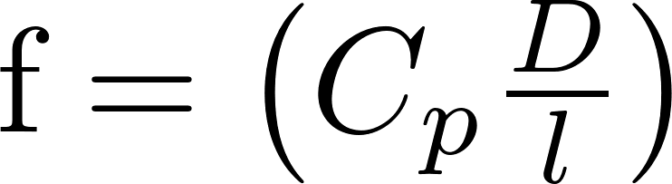
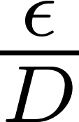
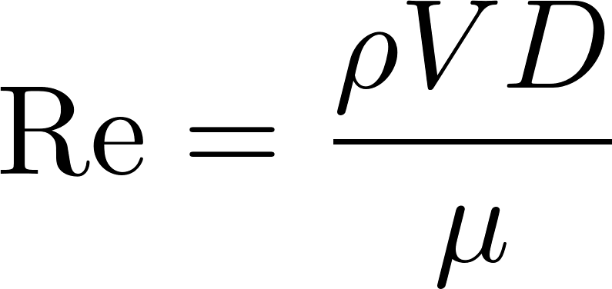
Frictional Losses in Straight Pipes: Moody Diagram
0.1
0.05
0.04
0.03
0.02
0.015
0.01
0.008
friction factor
0.006
0.004
laminar
0.002
0.001
0.0008
0.0004
0.0002
0.0001
0.01
0.00005
smooth
1E+03
1E+04
1E+05
1E+06
1E+07
1E+08
Re

Slide 23
Head loss through a long, rough pipe with turbulent flow
Decreases with increased flow
Remains constant with increased flow
Increases approximately in proportion to the flow
Increases approximately in proportion to the square of the flow
Increases in proportion to the natural log of the flow

Slide 24
How do you design a pipe using the Moody Diagram?
I want a pipe that transports 10 L/s of water a distance of 100 m with less than 1 m of head loss.
Assume f = 0.02
Replace V with Q/A and A as f(D), then solve for D
Round up to the next available pipe size
Calculate V in the pipe given Q
Calculate the Re
Use Moody diagram to find f
If it is hard, there is probably a better way
Notes:
We haven’t talked about minor losses yet and that makes the analysis even more complicated.

Slide 25
In search of better design tools
I haven’t used the Moody diagram in decades
You shouldn’t use it either! (use our functions in FeatureScript or in Python)
We want tools that allow us to design so that when we change an input the design updates automatically
What else do we want it a design tool?
UNITS (Excel is NOT a good choice for design)
Dimensionally correct equations
Easy to create modular code that is reusable

Slide 26

Head Loss: Minor Losses
Head (or energy) loss (h_{L}) due to: outlets, inlets, bends, elbows, valves, pipe size changes
Losses are due to expansions
Losses can be minimized by gradual expansions
Minor Losses have the form where K_{e} is the loss coefficient and V is some characteristic velocity (could be contracted flow velocity or expanded flow velocity or some other convenient velocity)
When V↓, some KE → thermal

Slide 27
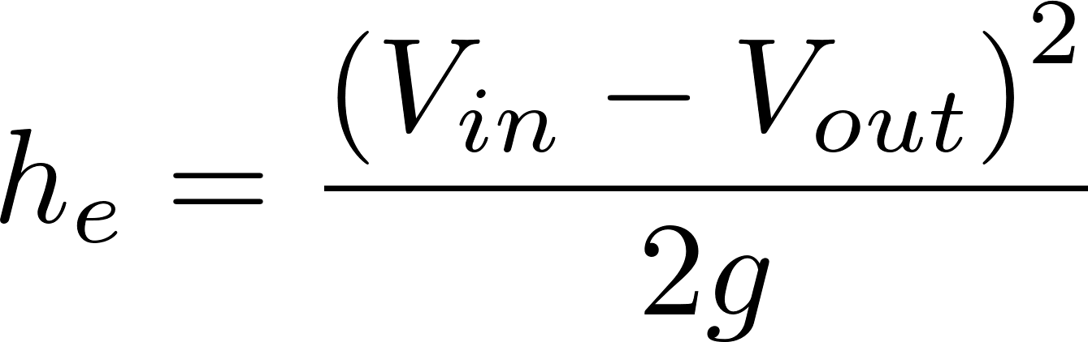
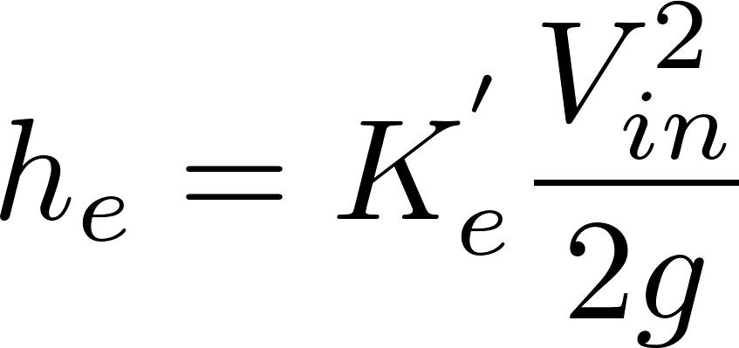
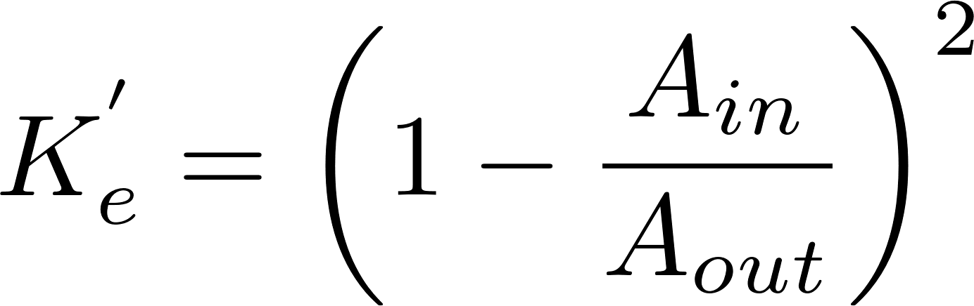
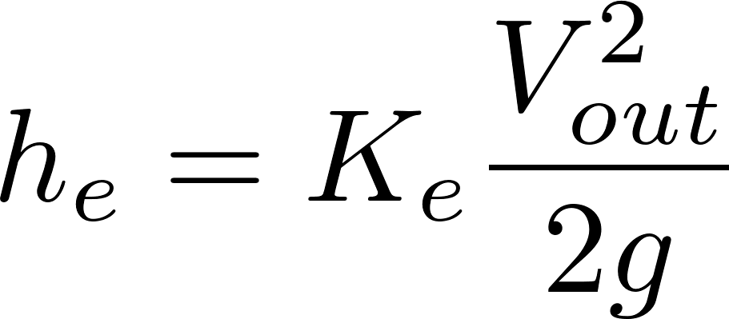
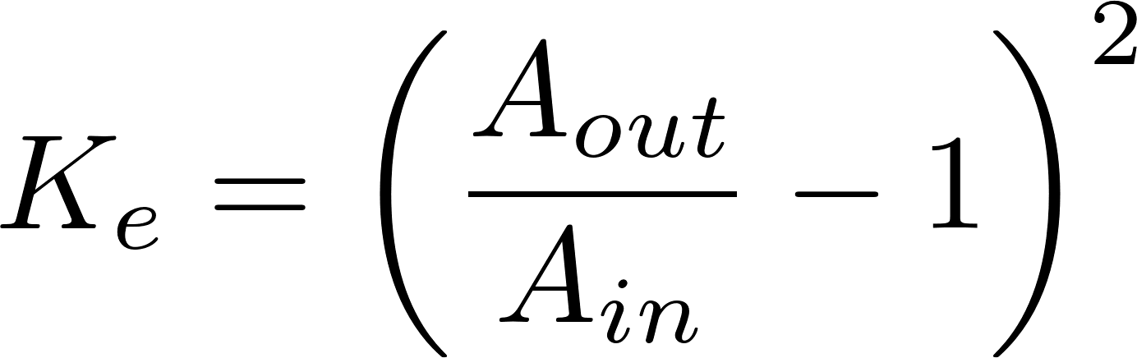
Three forms of Minor Loss equation
V_{in}
V_{out}
in
out
Most commonly used form
We have a case in flocculator design where the flow doesn’t ever fully expand and yet we use the V that would occur IF the flow fully expanded!
Notes:
Emphasize the minor loss coefficient is defined based on some relevant velocity. We can chose either V1 or V2. But the magnitude of the minor loss coefficient is determined by which velocity we use. We need to choose one and be consistent. The velocity that we choose will be a function of convenience. Minor losses are proportional to the square of the velocity. This is true whether the flow is turbulent or laminar!

Slide 28
Which points are `in` and `out` for finding the Minor Loss coefficient?
C
B
`in` should be where the flow is most compressed
A
`out` should be where the flow has fully expanded
Notes:
Draw the orifice case in detail showing expansion zone

Slide 29
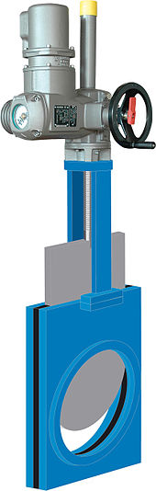
Three forms of Minor Loss equation
V_{in}
V_{out}
in
out
Most commonly used form
Which form of K can be greater than 1, K_{e} or K_{e}’?
What is the K_{e} for a pipe discharging into a lake?
What does it mean when K_{e} exceeds 1?
1
Suggests more kinetic energy was lost than what was available! Must mean that we are using a slower velocity as our characteristic velocity.
Notes:
Emphasize the minor loss coefficient is defined based on some relevant velocity. We can chose either V1 or V2. But the magnitude of the minor loss coefficient is determined by which velocity we use. We need to choose one and be consistent. The velocity that we choose will be a function of convenience. Minor losses are proportional to the square of the velocity. This is true whether the flow is turbulent or laminar!

Slide 30




When draining a tank through a valve
major losses dominate
minor losses dominate
minor losses are equal to major losses
Notes:
How could you think about this question?
How would you PROVE what the right answer is?
Write the equations for minor and major head loss

Slide 31

Elevation difference = head loss trick
Also called the ‘head loss trick’ or ‘control volume trick
We’d like to know how much water will flow through this tube
Goal is to use energy equation to find the head loss and then major and minor loss equations to find the flow
If tubing isn’t straight – another minor loss!
Small diameter tubing
Notes:
Why not at inlet to pipe? (would need to use Bernoulli to calculate pressure)
Show that vertical at outlet or horizontal at outlet is equivalent.
HL = fL/dV^2/2g + sumKV^2/2g

Slide 32

Let’s try to figure this out!
How could I get the velocities to cancel?
Let’s see…
Control volume
h
in
out
Not static! Must use Bernoulli to find this pressure! But we don’t know V!
FAIL!

Slide 33


Take 2
Add tank to control volume – V_{in}=0
Where can I put the out control surface so there is no velocity????
Add an imaginary water surface
The kinetic energy loss at the exit of the tube is now INSIDE our control volume
= entrance loss, tubing curvature loss, exit loss
Control volume
in
out
SUCCESS!
Notes:
Imaginary water surface has same elevation and pressure as the exit. But it has no kinetic energy.

Slide 34


Elevation difference = head loss trick
Also called the ‘head loss trick’ or ‘control volume trick’
Two unknowns! Q and head loss
Two equations?
Control volume
in
out
The kinetic energy term gets incorporated in head loss as a minor loss with a K_{e} of 1
Click here for a more in-depth explanation
Notes:
This trick is used extensively in this class,
understanding it will make it easier to understand
future course concepts!

Slide 35


Solar Pumped System in India
Water treatment facility
Minimum height for adequate pressure at highest tap
Maximum elevation change
Solar panels
Transmission Line Length
Pump control room
Minimum well water level

Slide 36

Will the pump be able to lift more water up to the tank if the vertical pipe is smaller diameter?
Yes
No
A 10 cm diameter pipe is used for the 500 m long transmission line. The elevated tank is 10 m tall.
Pressure at the bottom of the vertical pipe increases if there is more shear on the pipe walls (from higher velocity flow in smaller diameter pipe)!
Notes:
Pressure at the bottom of the pipe increases if there is shear on the pipe walls!

Slide 37

How can you make water flow up through a tank (by gravity)?

Slide 38







What happens next?
There can only be one pressure at a point!
This can not be a static situation!
1

Slide 39
How can you make water flow up through a tank (by gravity)?
Water flows from inlet to outlet as long as inletHW>outletHW
outlet
inlet

